Slide 1
Hierarchical Clustering
By
B A Sabarish
Nalinadevi K

Slide 2
Hierarchical Clustering
Agglomerative Clustering

Slide 3
Introduction
Hierarchical clustering is another unsupervised machine learning algorithm, which is used to group the unlabeled datasets into a cluster and also known as hierarchical cluster analysis or HCA.
hierarchy of clusters in the form of a tree, and this tree-shaped structure is known as the dendrogram.
Why
A predetermined number of clusters,
It always tries to create the clusters of the same size.

Slide 4
Approaches
Agglomerative: Agglomerative is a bottom-up approach, in which the algorithm starts with taking all data points as single clusters and merging them until one cluster is left.
Divisive: Divisive algorithm is the reverse of the agglomerative algorithm as it is a top-down approach.

Slide 5
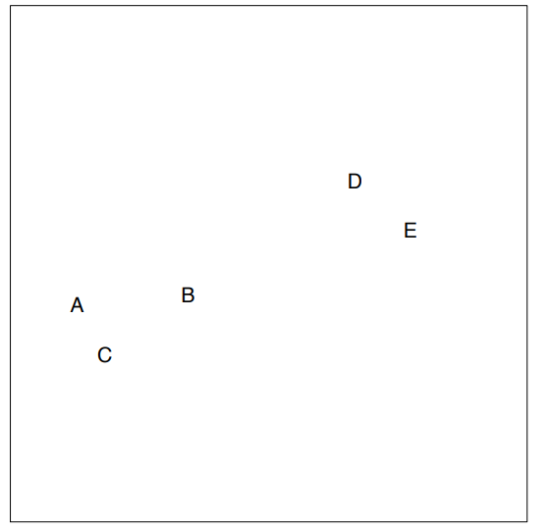
Agglomerative Hierarchical clustering
Step-1: Create each data point as a single cluster. Let's say there are N data points, so the number of clusters will also be N.

Slide 6
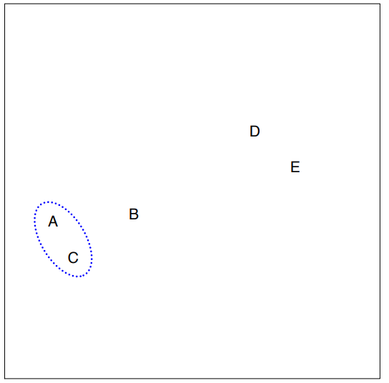
Agglomerative Hierarchical clustering
Step-2: Take two closest data points or clusters and merge them to form one cluster. So, there will now be N-1 clusters.

Slide 7
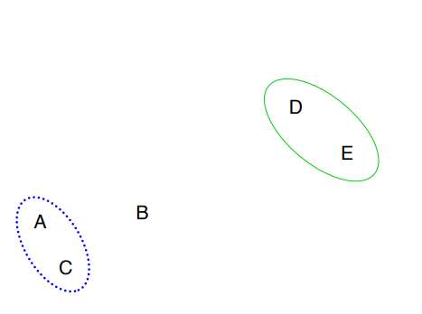
Agglomerative Hierarchical clustering
Step-3: Again, take the two closest clusters and merge them together to form one cluster. There will be N-2 clusters.

Slide 8
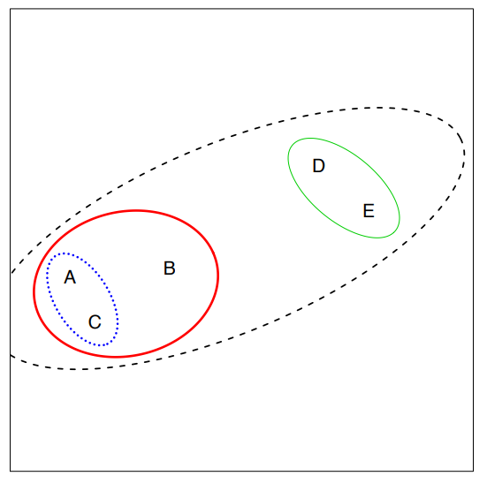
Agglomerative Hierarchical clustering
Step-4: Repeat Step 3 until only one cluster left. So, we will get the following clusters.

Slide 9
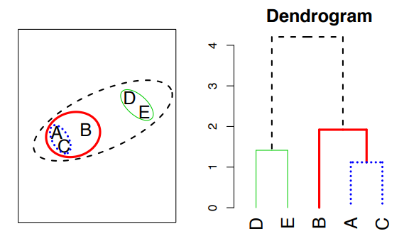
Result

Slide 10
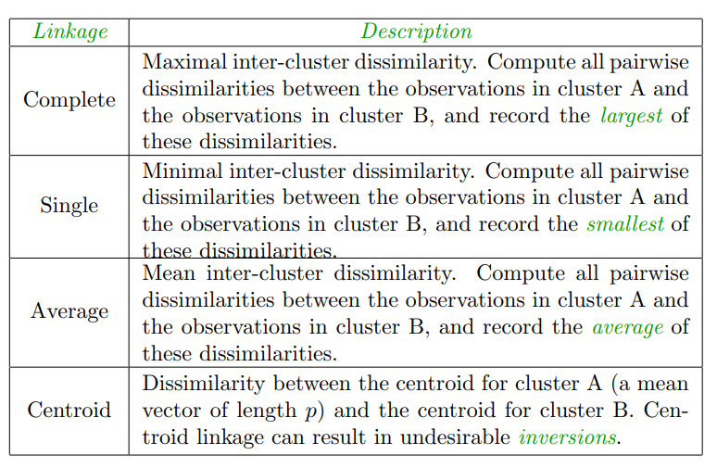
Linkage Measure/ Measure for the distance between two clusters

Slide 11
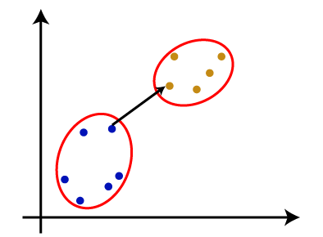
Single Linkage - Definition
It is the Shortest Distance between the closest points of the clusters.

Slide 12
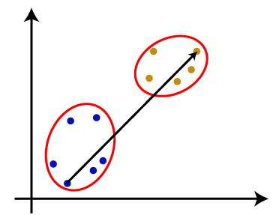
Complete Linkage - Definition
It is the farthest distance between the two points of two different clusters. It is one of the popular linkage methods as it forms tighter clusters than single-linkage.

Slide 13
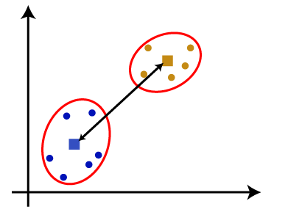
Average Linkage and Centroid Linkage - Definition
Average Linkage: It is the linkage method in which the distance between each pair of datasets is added up and then divided by the total number of datasets to calculate the average distance between two clusters. It is also one of the most popular linkage methods.
Centroid Linkage: It is the linkage method in which the distance between the centroid of the clusters is calculated. Consider the below image:

Slide 14
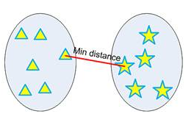
Single Linkage - Example
single linkage hierarchical clustering or nearest neighbor clustering
Distance between two clusters is defined by the minimum distance between objects of the two clusters

Slide 15
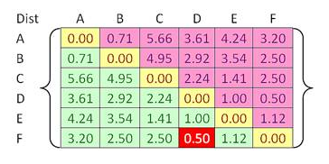
Single Linkage - Example

Slide 16
Single Linkage – Example- Step 1
Beginning with 6 clusters. Our goal is to group those 6 clusters such that at the end of the iterations, have only single cluster consists of the whole six original objects.
closest cluster is between cluster F and D with shortest distance of 0.5. Thus, we group cluster D and F into cluster (D, F).

Slide 17
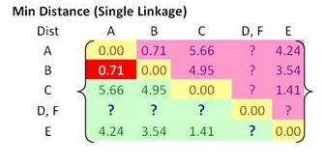




Single Linkage – Example – step 1
single linkage, minimum distance between original objects of the two clusters.
Using the input distance matrix, distance between cluster (D, F) and cluster A is computed as

Slide 18
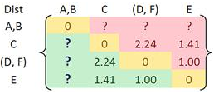
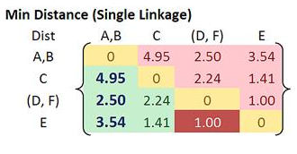

Single Linkage – Example – Step 2
Closest distance between cluster B and cluster A is now 0.71. Thus, we group cluster A and cluster B into a single cluster name (A, B).

Slide 19
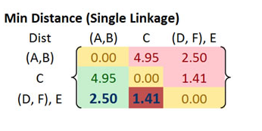
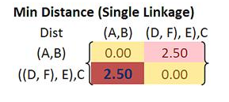
Single Linkage – Example – step 3 & 4

Slide 20
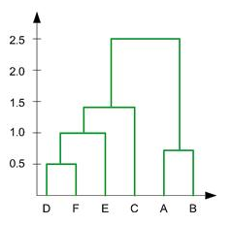
Single Linkage - Summary
In the beginning we have 6 clusters: A, B, C, D, E and F
Merge cluster D and F into cluster (D, F) at distance 0.50
Merge cluster A and cluster B into (A, B) at distance 0.71
Merge cluster E and (D, F) into ((D, F), E) at distance 1.00
Merge cluster ((D, F), E) and C into (((D, F), E), C) at distance 1.41
Merge cluster (((D, F), E), C) and (A, B) into ((((D, F), E), C), (A, B)) at distance 2.50

Slide 21
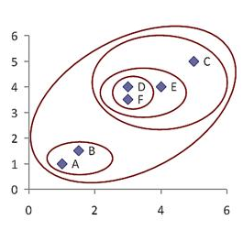
Single Linkage - Dendogram

Slide 22
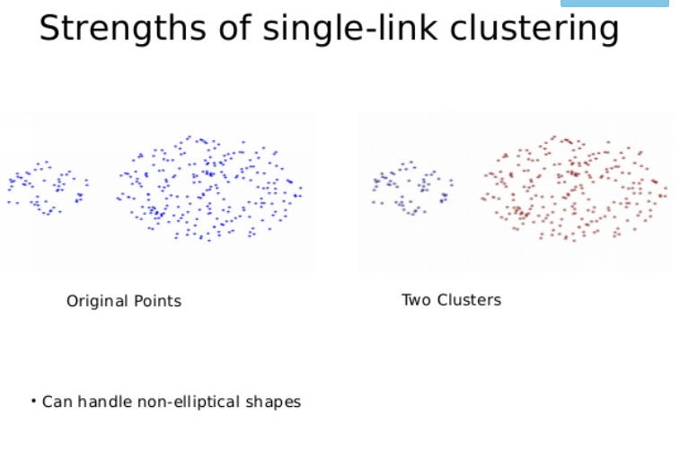

Slide 23
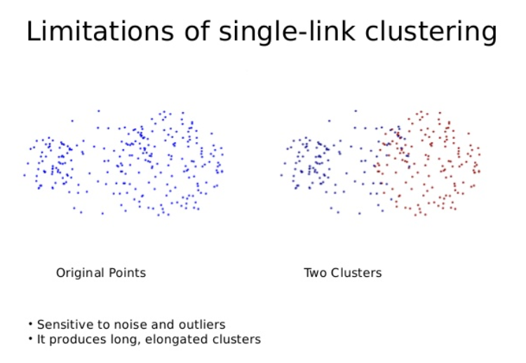

Slide 24
Complete Linkage – Example – Step 1
Beginning with 6 clusters. Our goal is to group those 6 clusters such that at the end of the iterations, have only single cluster consists of the whole six original objects.
closest cluster is between cluster F and D with shortest distance of 0.5. Thus, we group cluster D and F into cluster (D, F).

Slide 25
Complete Linkage – Example – Step 1
A B C D E F
complete linkage, maximum distance between original objects of the two clusters.
Using the input distance matrix, distance between cluster (D, F) and cluster A is computed as
d_{(D,F)→A} = max(d_{DA}, d_{FA}) = max(3.61, 3.20) =3.61
d_{(D,F)→B} = max(d_{DB}, d_{FB}) = max(2.92, 2.50) =2.92
d_{(D,F)→C} = max(d_{DC}, d_{FC}) = max(2.24, 2.50) =2.50
d_{(D,F)→E} = max(d_{DE}, d_{FE}) = max(1.00, 1.12) =1.12
A
B
C
D
E
F
0.00
0.71 | 0.00
5.66 | 4.95 | 0.00
3.61 | 2.92 | 2.24 | 0.00
4.54 | 3.54 | 1.41 | 1.00 | 0.00
3.20 | 2.50 | 2.50 | 0.50 | 1.12 | 0.00
A B C D,F E
A
B
C
D,F
E
0.00
0.71 | 0.00
5.66 | 4.95 | 0.00
3.61 | 2.92 | 2.5 | 0.00
4.54 | 3.54 | 1.41 | 1.12 | 0.00

Slide 26
Complete Linkage – Example – Step 2
Choose the minimum distance between A and B
Using the input distance matrix, distance between cluster (A,B) and cluster C is computed as
d_{(A,B)→C}= max(d_{AC}, d_{BC}) = max(5.66, 4.95) =5.66
d_{(A,B)→(D,F)}= max(d_{A(D,F)}, d_{B(D,F)}) = max(3.61, 2.92) =3.61
d_{(A,B)→E}= max(d_{AE}, d_{BE}) = max(4.54, 3.54) =4.54
A B C D,F E
A
B
C
D,F
E
0.00
0.71 | 0.00
5.66 | 4.95 | 0.00
3.61 | 2.92 | 2.5 | 0.00
4.54 | 3.54 | 1.41 | 1.12 | 0.00
A,B C D,F E
A,B
C
D,F
E
0.00
5.66 | 0.00
3.61 | 2.92 | 0.00
4.54 | 3.54 | 1.41 | 0.00

Slide 27
Complete Linkage – Example – Step 3
Choose the minimum distance between D,F and E
Using the input distance matrix, distance between cluster((D,F) ,E)and cluster (A,B) is computed as
d_{(D,F),E)->(A,B)} = max(d_{(D,F)->(A,B)}, d_{E->(A,B)}) = max(3.61, 4.54) =4.54
d _{(D,F),E)->C}= max(d_{(D,F)->C}, d_{E->C}) = max(2.92, 3.54) =3.54
A,B C D,F E
A,B
C
D,F
E
0.00
5.66 | 0.00
3.61 | 2.92 | 0.00
4.54 | 3.54 | 1.41 | 0.00
A,B C D,F,E
A,B
C
D,F,E
0.00
5.66 | 0.00
4.54 | 3.54 | 0.00

Slide 28
Complete Linkage – Example – Step 4
Choose the minimum distance between D,F,E and C
Using the input distance matrix, distance between cluster(((D,F) ,E),C) and cluster (A,B) is computed as
d_{((D,F),E),C)->(A,B)} = max(d_{((D,F),E)->(A,B)}, d_{C->(A,B)}) = max(4.54, 5.66) =5.66
A,B C D,F,E
A,B
C
D,F,E
0.00
5.66 | 0.00
4.54 | 3.54 | 0.00
A,B D,F,E,C
A,B
D,F,E,C
0.00
5.66 | 0.00

Slide 29
Complete Linkage - Summary
In the beginning we have 6 clusters: A, B, C, D, E and F
Merge cluster D and F into cluster (D, F) at distance 0.50
Merge cluster A and cluster B into (A, B) at distance 0.71
Merge cluster E and (D, F) into ((D, F), E) at distance 1.41
Merge cluster ((D, F), E) and C into (((D, F), E), C) at distance 3.54
Merge cluster (((D, F), E), C) and (A, B) into ((((D, F), E), C), (A, B)) at distance 5.66
Draw the dendrogram !!!!!

Slide 30
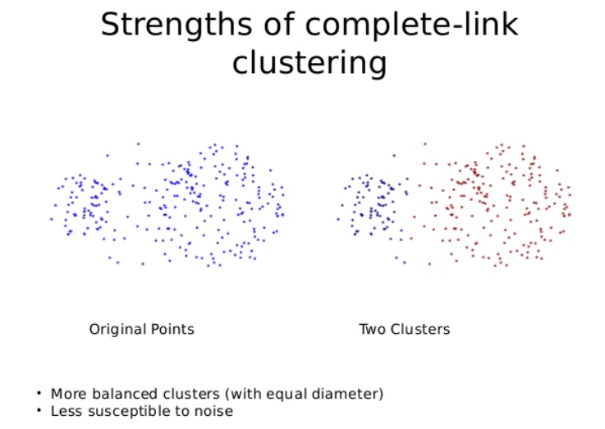

Slide 31
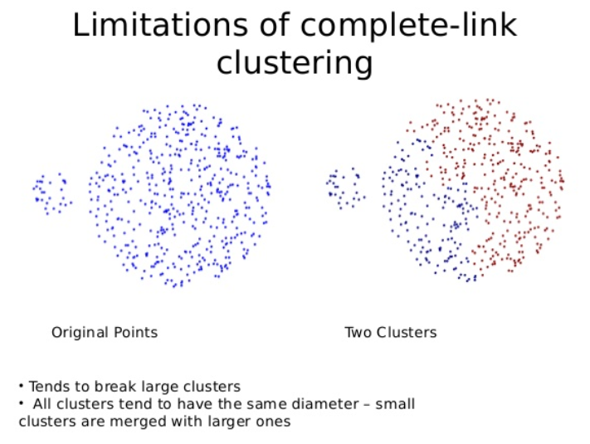

Slide 32
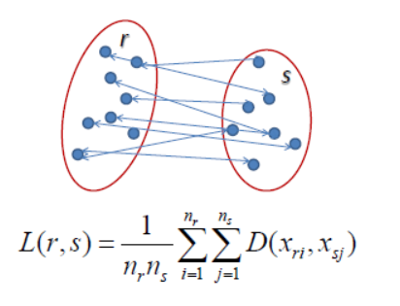
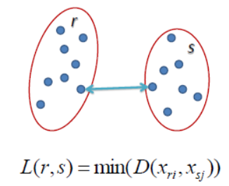
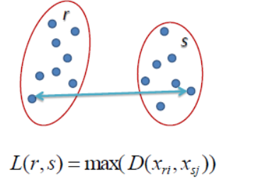
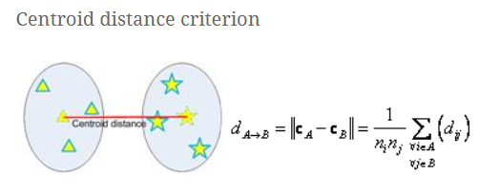
Single Linkage Complete Linkage Average Linkage
(Centroid Linkage)

Slide 33
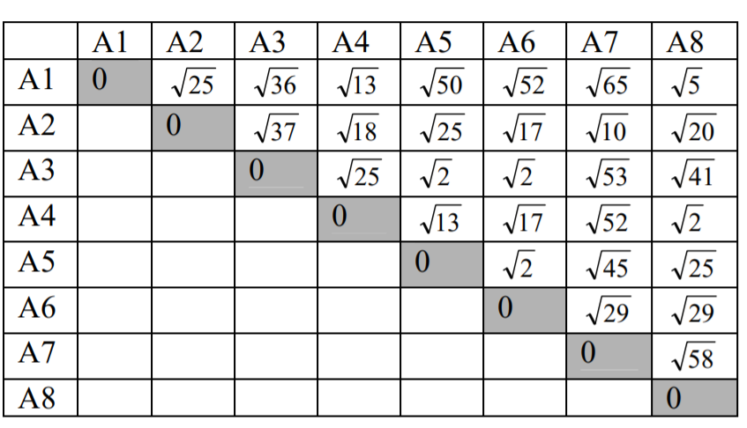
Try all the 4 linkage on this distance matrix !!!!!!

